Slide 1
An Information Age
Levenchuk Liudmyla, ka-72mp

Slide 2
Contents
What is Information Age?
A brief history of the information age
Information age & communication
Information age & education
Internet in education
Information age & daily life
Summary

Slide 3

What is Information Age?
The Information Age is a concept that characterizes the current age by the ability of individuals to transfer information freely and have instant access to information that would have been difficult or impossible to access in the past.
The idea is linked to the concept of a digital age or digital revolution, as most of this information is instantaneously available online.

Slide 4
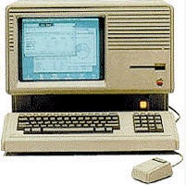

A brief history of the information age
Personal computers had become widespread by the end of the 1980s.
Through a device called a modem, individual users could link their computer to a wealth of information using conventional phone lines.
The Internet was developed during the 1970s.
The development of fiber-optic cables allowed for billions of bits of information to be received every minute.
Companies like Intel developed faster microprocessors, so personal computers could process the incoming signals at a more rapid rate.
In the early 1990s, the World Wide Web was developed, in large part, for commercial purposes.

Slide 5
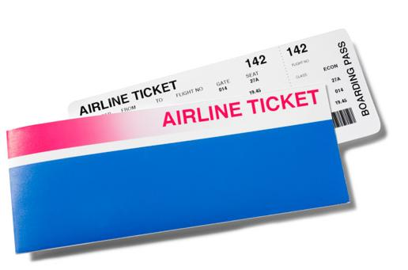




A brief history of the information age

Slide 6


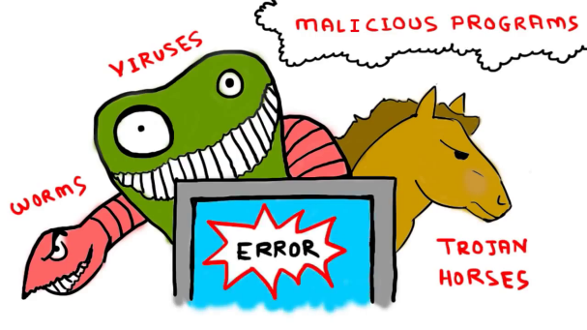

Information age & communication
Email is a way of interacting with others over the web instantly without it costing any money. All of this can be done at no cost once you have the equipment. Emails can contain viruses.
Another way of communicating over the web can be over social networking sites, such as Facebook, which is extremely popular.

Slide 7

Information age & education
Many universities are pursuing virtual degree programs, offering classes via the Internet.
Computer technology can be used in real-time education.
With the use of broadband internet, teachers and students can get real-time example on specific subjects.

Slide 8


Internet in education
The Internet can be most useful for completing projects in schools and colleges.
Sometimes, an encyclopedia may not always be available to students and they may have difficulty in gaining access to the books in the library.
All the latest news are constantly updated on the Internet on news sites.
Historical accounts like speeches, biographies, etc., are also easily available on the Internet in detailed and accurate versions.
Distance education or online learning.
Online courses provide an opportunity for people of all age groups to take up education of their choice, according to their liking and wish.

Slide 9
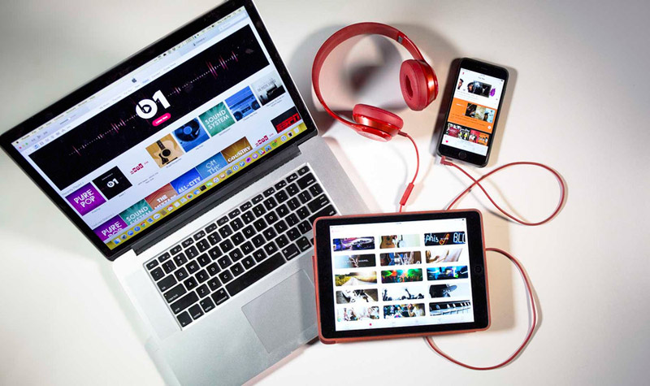



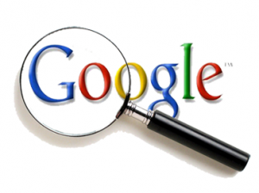
Information age & daily life

Slide 10
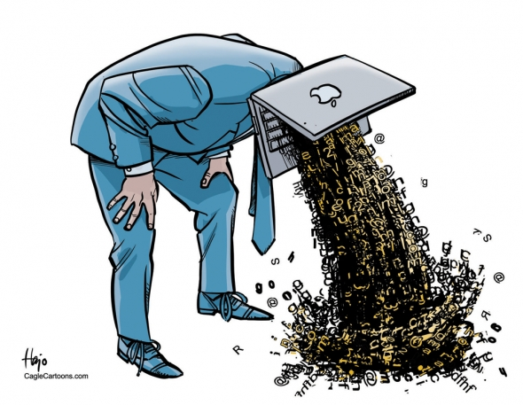
Summary
The information age began in 1970 and still carries on today.
The effects on society of these changes can be seen on communication, education, online banking and lifestyle in general.
Technology has changed the way we communicate with each other and with technology and the internet we can keep in contact with people that live far away for free and without costing also of money.

Slide 11
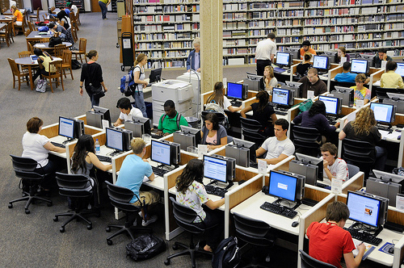

Summary
There are many websites where people of all age groups can access information and revision notes about subjects they are studying.
The internet access also allows the students to get different educational resources from all over the world.
A lot of different working styles have been created because of the information age as well such as working at home, telephone sales, etc.

Slide 12
Thank you for your attention

